Slide 1
Slam bidding. The way beyond 3NT

Slide 2
Slam bidding always start with the opening bid. I will shortly describe the most used systems. 1. SAYC, normally 5-5-3-3 where you open the better minor Opening strenght on the 1-level, 11-21 hcp. Some play 5-5-4-2, and 2/1 by Responder as GF. Pros: You show your suit first Cons: The range is wide, and you can´t be sure about the minor suit length. In order to jump on the second round you need about 16-20 p

Slide 3
2.
ACOL All 1-level openings show 4+ suit, 11-21 hcp Pros: You know about the opening suits length Cons: 1M can be only 4-c, and the same 11-21 range

Slide 4
3.
Strong club Pros: You start by showing hcp, 1C=17+, you can establish GF at a low level. The gaps are 11-16 and 17+. A jump in the second round is 14-16 p Cons: The 1C opening is exposed to interference

Slide 5
4.
2-way club and Polish club
Pros: All strong hand goes thru 1C=17+ or 11-13 bal. Not as exposed to interference, opps need to have constructive overcalls, you also separate the 11-13 bal hands which means 1D is 4+ unbal. 2C shows 5+ suit Cons: Could be a problem with high level interference

Slide 6
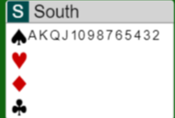
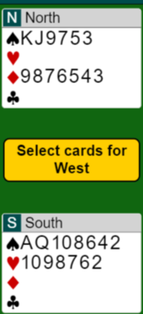
How many points do you need to bid a slam? That varies a lot, if you have 2 balanced hand with no 5-c suit, you prob need 33p to make 6NT.
But if you have these hands, you easily make 7S

Slide 7
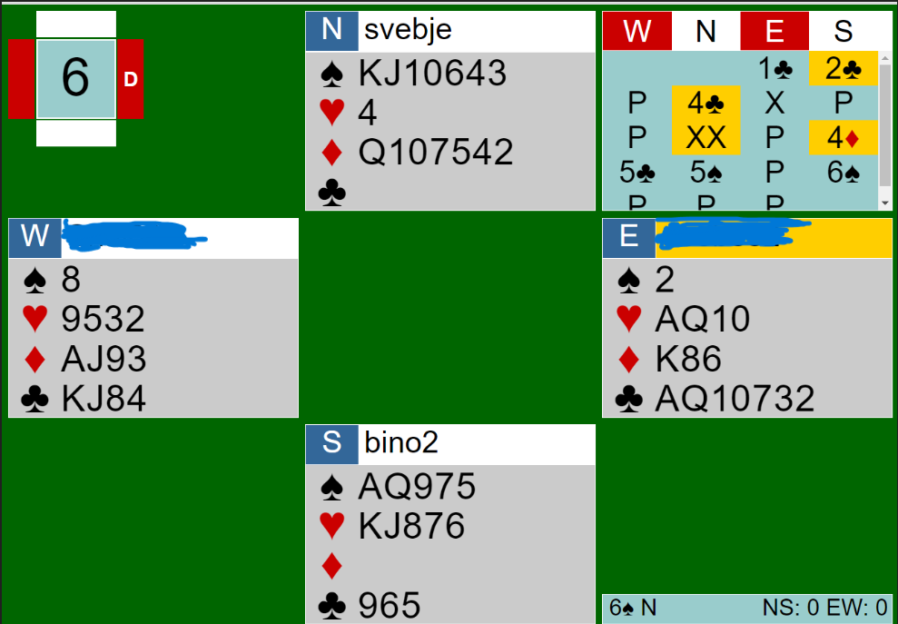
To show that you dont need a lot of hcp to bid a slam is illustrated by this hand we had recently. E opend 1C and 2C showed a decent hand with 5-5 in M. I could see a potential crossruff, so I made a 4C cuebid. East doubled which helped me to show a void. At the other table they doubled 5S, but all their points didn´t help much.

Slide 8
When I am interested in slam, I ask myself: Do we have a fit in our suits?
Can we take 12 tricks?
Can the opps cash 2 quick tricks?
Are we missing 2 aces?
The tools you use is:
Show trump support immediately Use cuebids / splinter bids
Ask for aces, using 4NT RKC, Kickback or Minorwood
which ever you like. I prefer Kickback or 4NT RKC

Slide 9
4NT RKC When a suit is agreed 4NT asks for aces. Replies: 5C= 0 or 3, 5D= 1 or 4, 5H = 2 without trump Q, 5S= 2 with the Q. 5NT=1/3 and a void. 6X= 2 with a void in X. Some play 5C=1/3, decide with your Partner. After replies next step outside trumps asks for the Q if not showed, 2 steps asks for Kings up-the-line. If the Q is shown, then 1 step asks for Kings
Kickback The bid above trumps on the 4-level = RKC. Same stepwise respons as after 4NT
Minorwood 4 in agreed minor is RKC Same stepwise respons as after 4NT

Slide 10
When P opens 1M and I have 3+ support and GF, I show support immediately using 2NT.
When P opens 1 C/D I would use inverted raise meaning 4+ support and 10+ p.
I am no expert on this because I have not played it, but
after 1C-2C, I would probably use 2NT as 12-14 denying 4+ C,
and other bids promising 4+ C. There are other experts that knows this better .

Slide 11
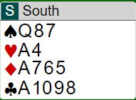
The Svencoby 2NT
Your P opens 1S and you hold:
Now OP bids 3C showing min, 11-14p. Can we still have a slam? Probably not, but you should bid 3S to keep it open. OP may have a good 5-5 but not more than 14p. If OP bids 3D=extras, 3H=extras spl C, 3S=extras spl D or 3NT=extras, spl other M, you should cuebid and push on
There is no meaning in bidding 2C. Establish S supp and GF thru 2NT

Slide 12
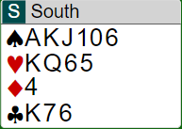
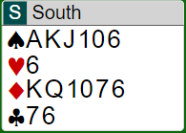
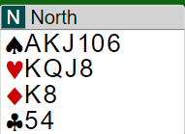
1 2 3
1.
1S-2NT;3S=extras short D, 4C cue, 4H cue 4NT RKC, 5H=2 without Q, 5NT=we have all key cards, 6C=I have the Club K. 6S=Thats not enough for me.
2.
1S-2NT;3C=min less than 14p 3S=still interested
3NT=serious slam interest less than 14p
4C=cue, 4D=cue, 4H cue. 4NT-5C=0/3, 5NT we have all key cards, do you have a king?
6S= No, can´t see 13 tricks
3.
1S-2NT;3D= extras no spl
3S=no spl, interested 4D=no C cue
4H= I have a club cue ( Last train) Then RKC, ending up in 6S
Responder

Slide 13
The concept:
1S 2NT
3C min
3D extras no spl 3H extras spl C
3S extras spl D
3NT extras spl other M
4C/D/H void at least a decent min
Extras = 14+ p and good slam cards
1S 2NT
3C 3D Asking for spl 3H No spl
3S spl C
3NT spl D
4C spl H
4S min 6 good S
1S 2NT
3C 3H spl
3S no spl asking for cuebid
3NT suggestion to play 4C/D spl

Slide 14
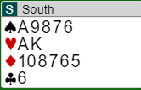
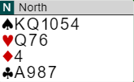
A recent hand
South opened 1S and North bids 2NT ”Svencoby”
Now 3C = min ( less then 14p). North could see the potential for a crossruff. He had 2 options over 3C, one is to show a D spl (by bidding 4D), The other is to ask OP if he has a spl.
The bidding so far if N asks for spl
1S-2NT 3C-3D (asking spl)
3S ( spl C ) – 4C (cue)
4H (cue) That denies a cue in D which looks very interesting . North should now cuebid 5D to check if OP has AK in H.
When South cuebids 5H, North should bid 6S

Slide 15
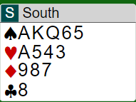
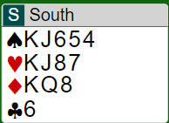
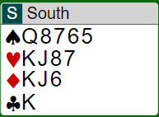
What is good slam cards?
Basically: Fillers in trump and a side suit, aces on the side.
Really good cards
Medium
Bad cards

Slide 16
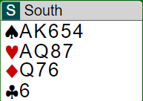
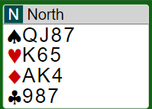
Splinter bids is a very useful tool, it shows your points will work in the other suits.
A
B
C
You have agreed a M and P shows a spl in C
In A its decent to have the Ace of clubs when P shows a spl. You will not loose a club, but you still may loose 2 D tricks.
In B you surely will only loose 1 C trick, but no D looser
In C your C king 3p may be completely useless
And if the spl is a void, the K is absolutely useless, and the Ace might be
The biddding would go: 1S-2NT
3H = extras with short C. Now N can go RKC because he knows OP has 14+p outside clubs

Slide 17
Void splinters.
When P opens 1M a double jump is a void with 4+ supp, 11+p.
1S-4C/D = void 11+ p
1S-3NT = void in the suit below the opened M.
The reason is I give OP a chance to react below 4M bye cuebids or Last Train.
Last train = normally the suit below trumps, does not promise a cue, but sometimes it shows a cue OP denied. Shows interest in slam

Slide 18
A singelton spl.
If I have GF strength I go thru 2NT and then show my spl.
These spl occurs in many situations. Rule is an unnecessary jump is a spl.
1S-2C
2H-4D = spl with H supp
1D-1S
2D-4C = spl with D supp

Slide 19
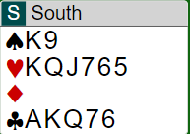
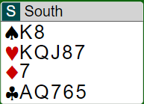
Exclusion Blackwood ( also called Voidwood )
1S – 2H
3H – 5D = How many aces do you have outside diamonds?
Rule: A jump to a suit over the agreed trump is Voidwood
4NT RKC
1S - 2H
3H - 4NT
5C – 5NT = show kings up the line 5C = 0/3 Aces and you must assume its 3. If you where misssing the HQ you could ask by bidding 5D, and OP could bid 6C to show both the H Queen and the C King

Slide 20
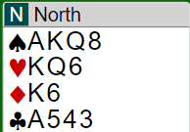
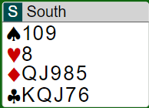
Minorwood and Kickback. When you use 4NT RKC with a minor as trump, you risk to get above the security level if P doesn´t have enough keycards.
North opens 2NT and South bids 3S which is a slam try with both minors. North bids 4C and now what? If South asks for Aces with 4NT they get to high.
If you use Kickback, then 4D over 4C is RKC, now you have plenty of space
If you play Minorwood, then already 4C would be asking for Keycards

Slide 21
4NT as RKC Pros: You can use the 4-level for cuebids and 5m as sign off
Cons: Risk of getting to high
Kickback: Pros: You can always stay at the 5-level if you are missing an ace and the trump queen. Cons: You can´t cue the suit above trumps, and there is a GREAT risk for misunderstanding. Example: 1D-1H 3D-4D 4D is GF, now what?
4H? RKC?, cuebid? suggestion? You need a finetuned partnership to manage this
Minorwood: Pros: You can use other bids on the 4-level as cue. Cons: Opps can have 2 quick tricks if you dont cue, and the same GREAT risk for misunderstanding.
1D-1H
3D-4D 4D is GF, now what? Is it Minorwood?

Slide 22
Last Train: The cuebid just below 4 in the agreed M can be used as Last Train. 1S-2H;3S-4D*;4H=Last train, promises a C cue, says nothing about H cue
1S-4D* ( void ) – 4H=still interested, doesn´t not promise a H cue
Serious/
Non serious: A relay saying ”I have a serious slam interest”. If you make a cuebid instead, its non serious. 1S-2H 3H-3S Serious slam try -3NT Non serious with a S cue -4C Non serious cue
1S-2H 3H-3S* Serious 3NT Shows a S cue

Slide 23
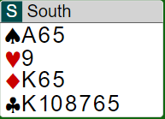
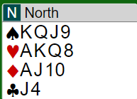
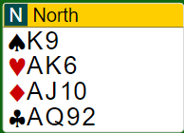
North opens 2NT, 20-21. Now your system allows you to bid 4C as a slam try with 6+ suit
You would like to sign off in 4NT which you can´t if 4C is Minorwood
With this hand you accept the slam try.
If you play 4NT as RKC, you start with 4D cuebid.
If you play Kickback you bid 4D as RKC

Slide 24
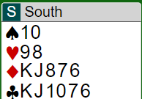
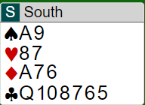
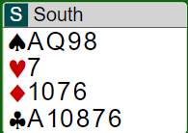
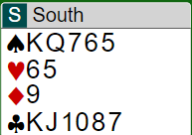
When should I move on over 3NT with one or both minors?
If you can picture a minimum hand where a slam is laydown, then you should invite. Your P opens 2NT 20-21
Bid 4C to show slam interest with 6+ clubs
Ask for Major. If OP denies 4S, you should bid 4C as slam try with 5+ C.
Bid 3S that shows slam interest with both minors
Trf to 3S. Then bid 4C to show 5-5(4).
If P:s 3S shows 3-c supp, then 4C=cue

Slide 25
P opens 1NT 15-17.
Now you need a system where you can make a slam try and still stay in 3NT
With a 6+m, bid 2S for C and 2NT for D. Now if P shows a fit by bidding 1 step, you can
show a spl to sometimes avoid 3NT or find a slam.
With 4-c M and 5+m, ask for M and later bid 3 in your minor if the M didn´t match. That would be a slam try or a way to find the best game.
With 5-4 in minors and 1-3 in M, bid 3in your 1-c M to show this hand
With 5-5 in minors bid 3D over 1NT.
Now the OP can set trump if he has a fit for your minors, and you can still stay in 5m

Slide 26
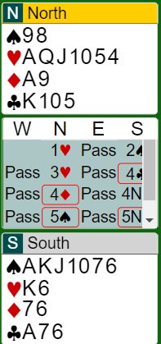
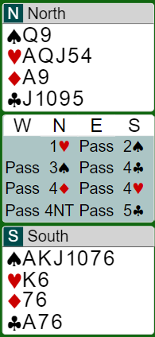
Weak or strong jumpshifts?
If you want a good platform to bid slams, use strong jumpshifts. When P opens 1X a jumpshift shows 6+ good suit a good opening hand and some slam interest. That means OP can raise with Hx or xxx and then you can start cuebidding.
No need for OP to rebid a weak suit or new suit. ( bid 2NT instead ) The problem if you don´t use jumpshifts it can be a problem later on to show this hand.
Some examples:
This time North has a good 6-c H suit ( and not a decent S supp).
South agrees H by cuebidding 4C. This time they could end up in 7H that only takes a 3-2 split in S to make.
South makes a GF jumpshift and North raises. They can start cuebidding where Souths 4H promise a top honor ( I dont recommend a spl cue in P:s 5-c suit ).
The Grand slam is easily bid.

Slide 27
When to use strong jump shifts? I recommend this:
1C/D/H - 2D/H/S = 13+ p at least a decent 6-c suit HHxxxx 1S – 3H = 13+ p, at very strong suit. OP:s new suit = cuebid. If they overcall, it retains its meaning. If they make a take out D, then it´s weak
1M – 3C/D is better used as supportshowing bids.
If you play 2/1 as GF you need to agree with your P
on this seq:
1M-2m
2X- 3m is slam interest or just confirming 6+ suit

Slide 28
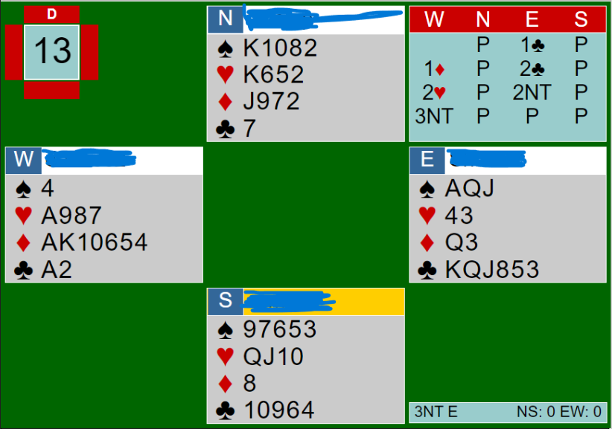
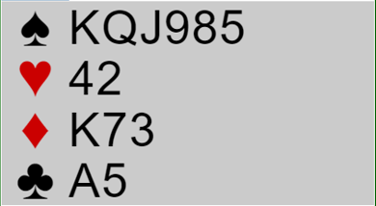
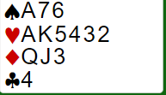
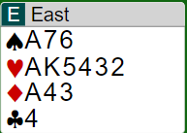
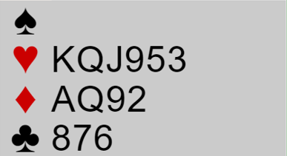
Some examples where you dont use strong jumpshifts:
OP could have had:
P opens 1H and you bid 1S. P now bids 2H. At one table they bid 4S, at the other 4H. A kind of guessing game. P held:
Or this hand:
If E-W used strong jumpshifts the bidding should go:
1C-2D
3C to promise a decent 6-c suit. Now they should reach 6 or 7 clubs.

Slide 29
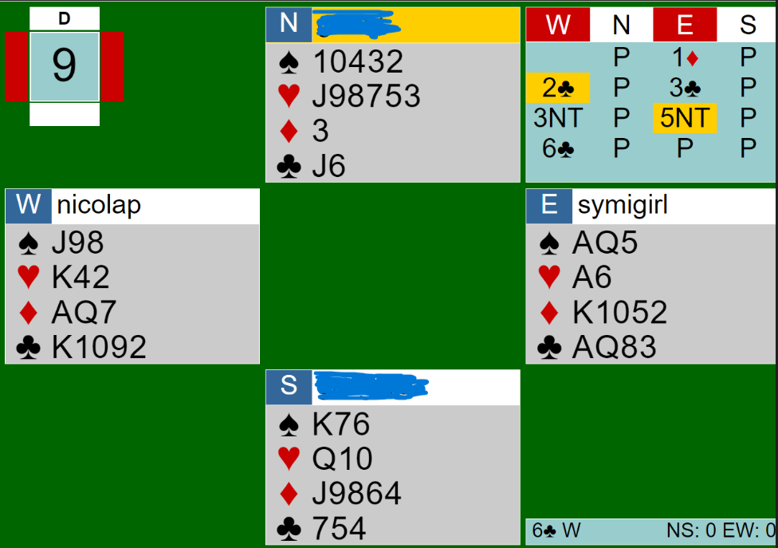
Quantitative 4NT .
Used when P has showed a NT hand and we haven´t agreed on a trump.
Typical: 1/2NT-4NT, If you don´t have a 5-c suit you should need 33p.
DO NOT use 2NT-5NT as a quant for 7NT, 2 extra Jacks will not guarantee 13 tricks.
I use 5NT as a very strong invite for 6NT, P can pass with subminimum.
This hand is a good example. 5NT was a very strong invite to 6NT and W who had close to submin thought there could be a extra trick in a club contract. Spot on! At the other table they bid 6NT – 1.

Slide 30
There are many situations where a jump to 4NT is quant. But you need to have an agreement with your partner. I use these:
1/2 NT -2/3C
2/3 D/H/S 4NT = quant. With support i use tools to show that
1S -2D
2H -3C
3NT -4NT = quant. No trump agreed

Slide 31
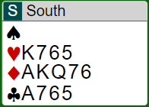
The 5NT trump quality ask.
You hold
Your P opens 4H. If he has the Ace of H you will bid 7. You can´t use 4NT because he may have the Ace of S instead of H.
Use a jump to 5NT. Now
6C = Ace or King 6D = Queen
Sometimes you can use exclusion blackwood, but that takes an agreement with P and may well
be misunderstood

